Slide 1
The W-Game הצגת הפרויקט
מנחה: גילעד נבות

Slide 2
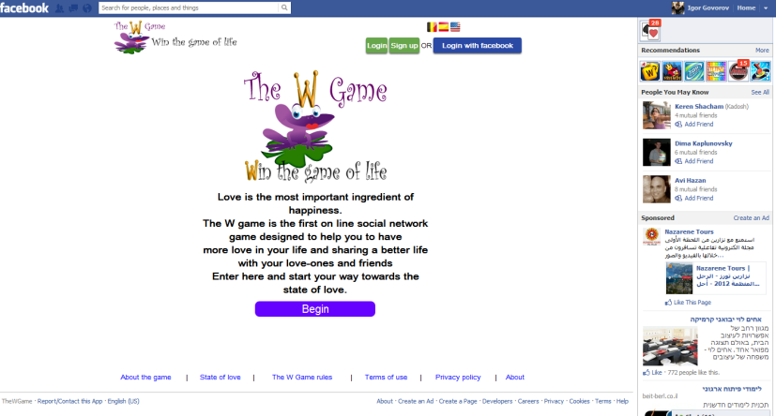
Project overview

Slide 3

Project overview - Goals
Framework Goals
Scaling
Cross Platforms
Decoupling
DB
Application goals
Questionnaire engine
User Collaboration
Mission logic
Facebook integration

Slide 4

Framework

Slide 5

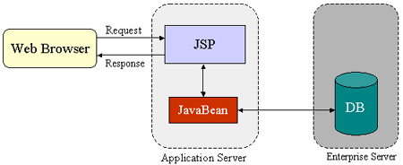
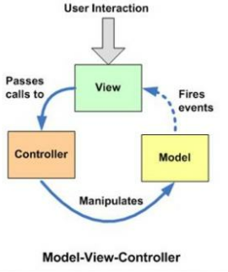
Framework – Design Pattern
Server pages
(JSP, ASP, PHP)
MVC

Slide 6
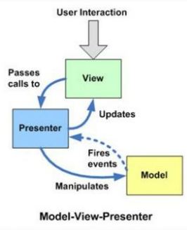
Framework – Design Pattern
We choose the MVP design pattern. Why?
Advantages:
Decupling
Cross platform
Dynamic client
Widget wise
Disadvantages:
Longer development time
Less efficient

Slide 7
Framework - Architecture
Server Side
Model
Asynchronic Calls
Client Side
Presenter
View

Slide 8
Framework - Architecture
Server Side
Model
Asynchronic Calls
Client Side
Presenter
gwt
View
View
XML (UI-Binder)

Slide 9
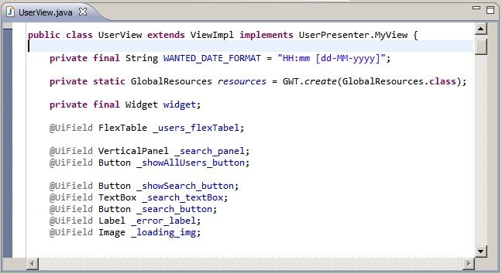
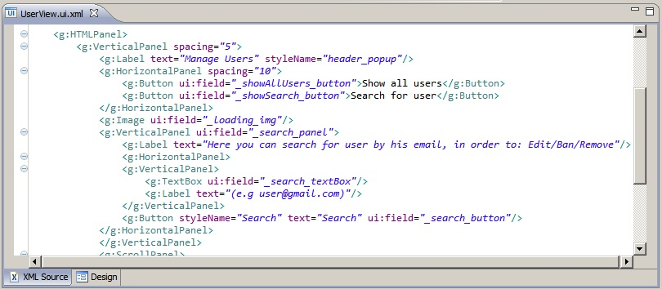

Slide 10
Framework - Architecture
Server Side
Model
Asynchronic Calls
Client Side
gwtP
Presenter
Presenter
gwt
View
View
XML (UI-Binder)

Slide 11
Framework - Architecture
Server Side
DataStore\Objectify
Data layer
Service layer
Model
GAE
Servlets
Asynchronic Calls
Client Side
gwtP
Presenter
Presenter
gwt
View
View
XML (UI-Binder)

Slide 12
Framework - Architecture
SomeObj.class
Server Side
DataStore\Objectify
Data layer
Service layer
Model
GAE
Servlets
Asynchronic Calls
Client Side
gwtP
Presenter
Presenter
gwt
View
View
XML (UI-Binder)

Slide 13
Framework - Client-server-db trade-off
Figure A
Figure B

Slide 14

Application

Slide 15

Application - Logic and Business rules
All the business rules are in the Service layer
Each service has the relevant Business Rules
DOR – Delete On Read
Unit tests – check this logic

Slide 16
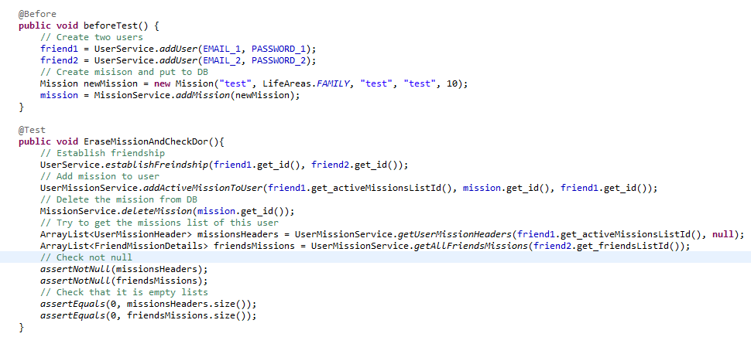
Application - Logic and Business rules

Slide 17
Application – mission delivery logic
Problem:
User wont get the same mission twice.
Friends wont get the same mission.
Efficient content flow

Slide 18
Application – mission delivery logic
Possible solutions
Every mission holds the users ids that took it
Every User will hold his “next mission”
Graph
Our solution:

Slide 19
Application – mission delivery logic
User
MissionsCommonness
_missionsCommonnessId : Long
_neverToShowAgainMissionId : Long
_id : Long
_hash : HashMap<Long, Integer>
MissionsNeverToShow
_id : Long
_hash : HashSet<Long >
All Missions Pool
Friends Missions
(each mission has a grade)
MissionService
_allMissions: HashSet<Long >
My missions

Slide 20
Application – user collaboration
Messages engine
Friends\self missions commenting
Friends missions ranking
Friends requests
Share on your Facebook wall

Slide 21
Application – message logic
Problem:
Efficient and reliable messaging engine
Open to future extensions

Slide 22

Application – message logic
User
ChatsContainer
_messagesReferenceId : Long
Id : Long
_table : HashMap<Long, Long>
Chat
Comment
Id : Long
_messages : ArrayList<MessagesId>
_lastMessageOf : Long
_id : Long
_ownerId : Long
_content : String
_date : Date

Slide 23
Application – comment and rank on friend’s mission
ArrayListObject
__objectIds: ArrayList<Long>
User
UserMission
_activeMissionsId: Long
_id : Long
_ownerId : Long
_status : MissionStatus _missionId : Long
_privateComment : : String
_commentsListId : Long
_rankersListId : Long
ArrayListObject
__objectIds: ArrayList<Long>
Mission
_id : Long
_type : LifeArea
_description : String
_tip : String
_tipPrice : int
Comment
_id: Long
_ownerId : Long
_comment : String
_date : Date
User
_frindsListId : Long

Slide 24
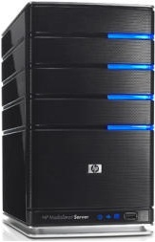

Application – friend request
Yael
Async: find jon.doe@gmail.com
JaneDoeBasicInfo : UserBasicInfo
Send frinds request to Jane with JaneId
Put YaelId in jane’s
_frindsRequests
Async update
Jane
Accept
Put Jane’s id in Yael’s friendsListIds
And opposite
Async : Update request

Slide 25



Application – Facebook integration
Social Plugins
Facebook JDK
Graph API

Slide 26
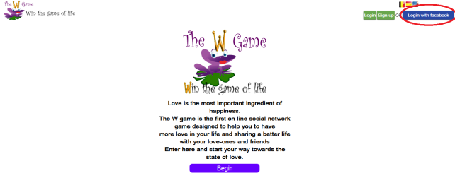
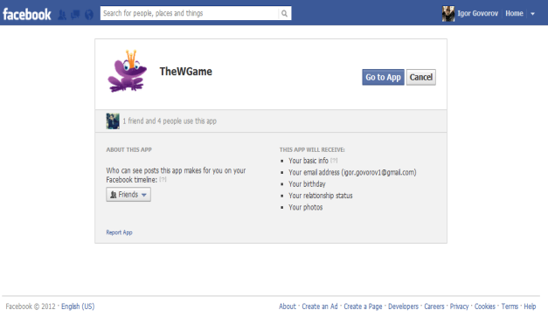
Application – Facebook integration
The W-Game application
Login with Facebook
Facebook – application confirmation
Code parameter
The W-Game
Code, App-Id, Secret
Facebook http server
User token
The W-Game
Email, Birthday date, pictures, friends….
Facebook http server

Slide 27
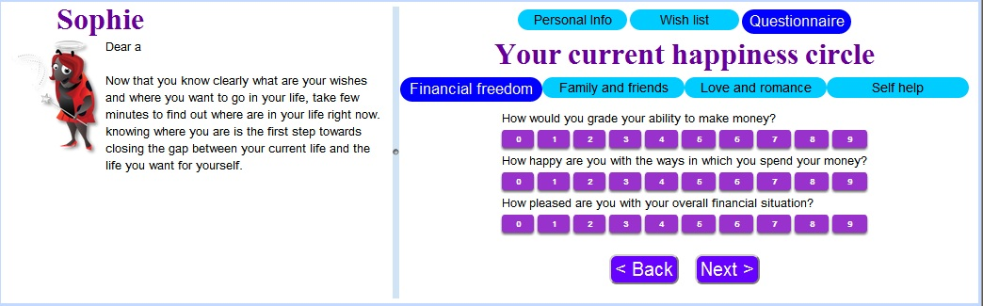
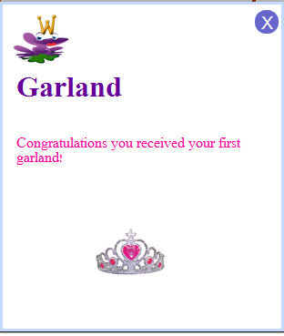
Application – questionnaire engine

Slide 28
Application – questionnaire engine
Questionnaire
User
_id : Long
_questions : ArrayList<String>
_id : Long
_garlandObjectId : Long
_qyestionnaireAnswersId: Long
GarlandObject
_id : Long
_familyPoints : int
_selfPoints : int
_lovePoints : int
_moneyPoints : int
_numOfCrowns : int
QuestionnaireAnswers
_id : Long
_questionnaireId: Long
_answers: HashMap<Integer, Integer>

Slide 29
Testing the product
Test group
http://www.youtube.com/watch?v=lg4S-M0R_I0
The W-Game team
Friends
Unit-Tests

Slide 30
Bibliography
Article about Design patterns
http://nirajrules.wordpress.com/2009/07/18/mvc-vs-mvp-vs-mvvm/
Big table
http://static.googleusercontent.com/external_content/untrusted_dlcp/research.google.com/en//archive/bigtable-osdi06.pdf
GWT (introduction by Ray Ryan 2009)
http://www.youtube.com/watch?v=PDuhR18-EdM

Slide 31

Questions

Slide 32
Application DEMO
User experience
Admin experience

